Slide 1

Electric Circuits
Neuromuscular Systems Control
Analyzing The Effect of Joint Movement Limitation on Asymmetry Using K-Means Clustering Method
Group Number : 4
Alireza Amiri Ali Bagheri Nejad
Fall 2023

Slide 2
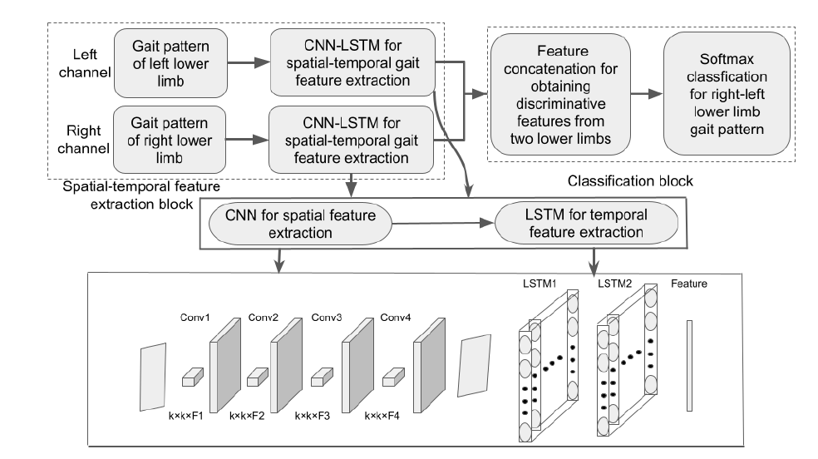
Early Identification of Gait Asymmetry Using a Dual-Channel Hybrid Deep Learning Model Based on a Wearable Sensor
Analyzing The Effect of Joint Limitation on Asymmetry Using K-Means Clustering Method

Slide 3
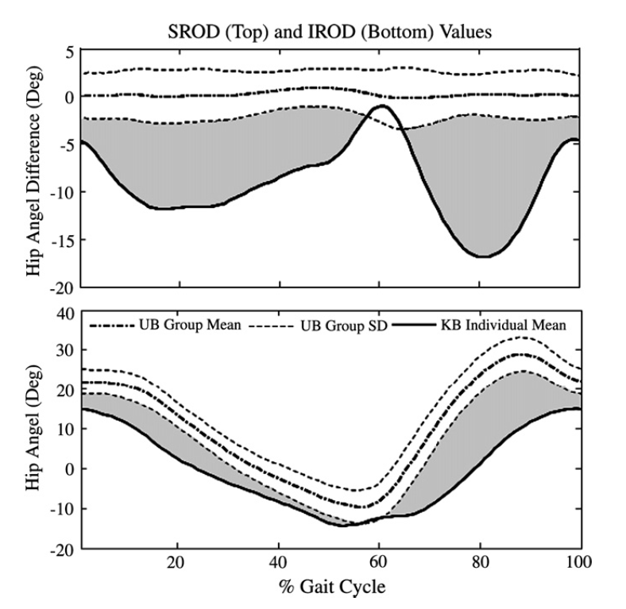
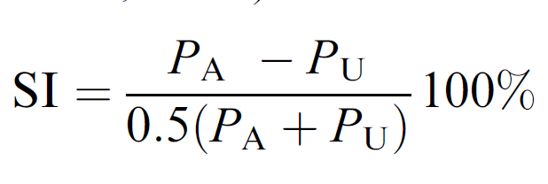
A new approach to detecting asymmetries in gait
Range Of Motion
Step Length
Step Width
Foot Rotation
Single Leg Support Time
Analyzing The Effect of Joint Movement Limitation on Asymmetry Using K-Means Clustering Method

Slide 4
Clustering Method
Type A
Type B
Data
Gait Cycles Segmentation
Feature Extraction
Clustering
Type C
Type D
[Reference]
Analyzing The Effect of Joint Movement Limitation on Asymmetry Using K-Means Clustering Method

Slide 5

Expected Result
Gait Asymmetry Type
$$Σ$$
Types of Gait Cycles
Effect of Asymmetry Indexes on Different Types
[Reference] : (Shorter et al., 2008; Wu et al., 2023)
Analyzing The Effect of Joint Movement Limitation on Asymmetry Using K-Means Clustering Method

